Slide 1

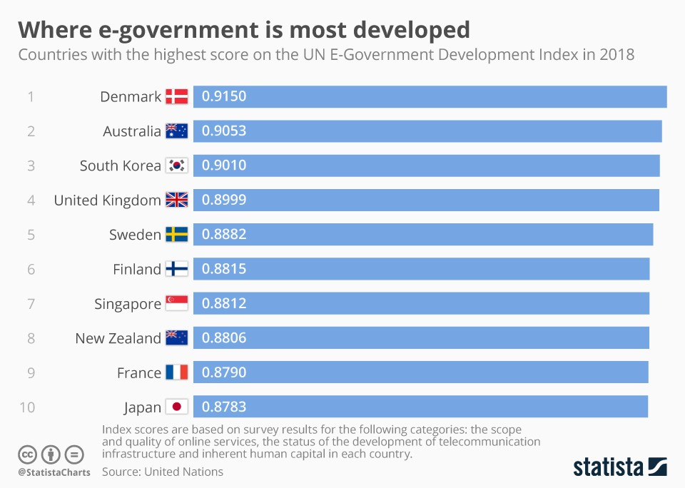
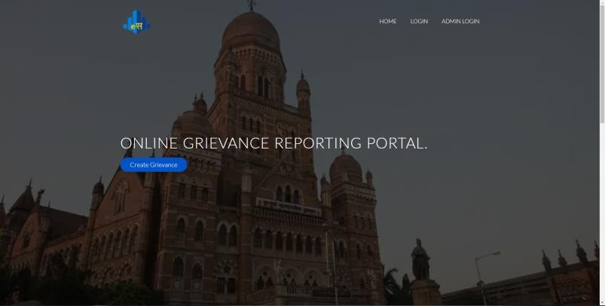


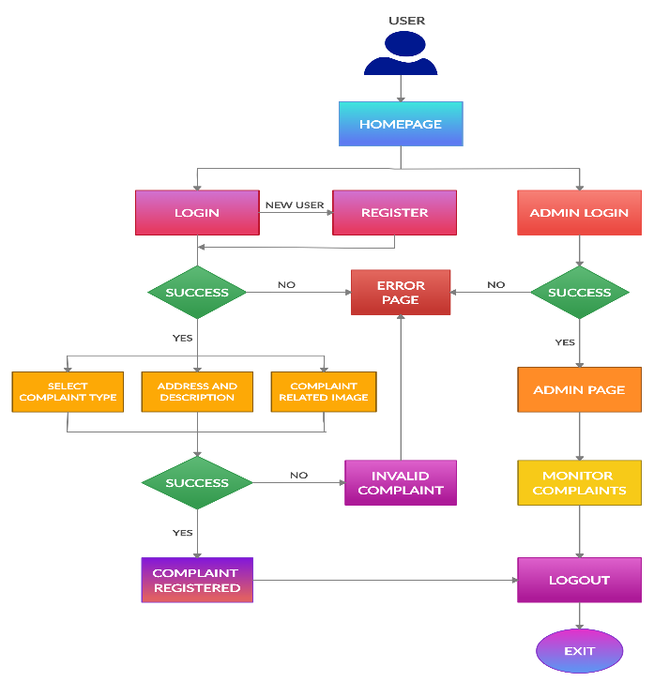
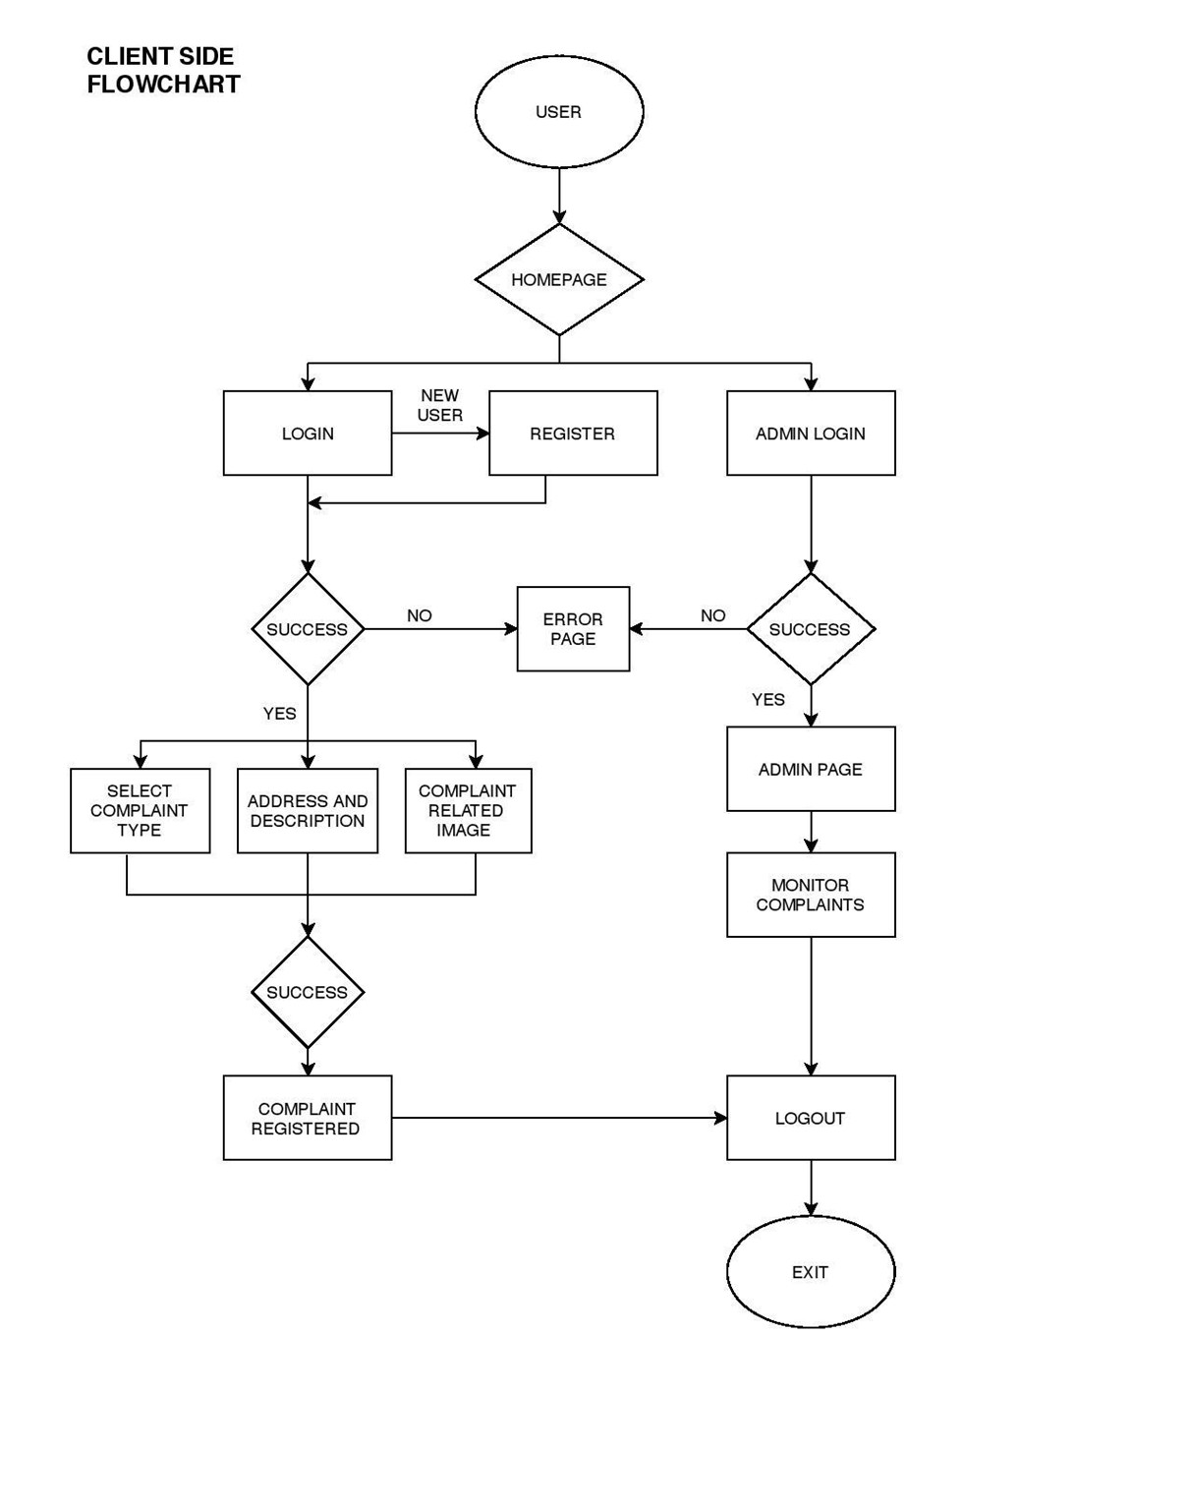



Agnel Charities’
Fr. C. Rodrigues Institute of Technology,
Vashi, Navi Mumbai, India
E-SAHAYA
GROUP 17 SE IT FCRIT, VASHI MUMBAI UNIVERSITY
ABSTRACT
In today’s World, progressive countries have achieved more than 96% of Digitalization in their Governing system. This makes governing a lot easier and people too, feel they are involved in the system. A major part of this is grievance reporting. It is possible because they have a small area and less density of population as compared to our country. So, the problem can be solved by first implementing such digitalization in smaller areas to check whether it is effective.
MEMBERS
AMAY RAVI TRIPATHI - 5019160
Email: amaytripathi16@gmail.co CRISTON CONRAD LOBO - 5019132
Email: cris10lobo@gmail.com
JIGNESH SHAILESH MATHURE - 5019137
Email: jigmaths2487@gmail.com
INTRODUCTION
Today, we are facing many civic issues, especially in populated cities. This is leading to an increasing number of complaint registries. A transparent and approachable mechanism is required [1]. This Application provides a way for the people who are facing problems due to civic issues to register a complaint using images and enables a transparent medium through which users can register a complaint and confirm the same. The image and the date/time of the registered complaint are immediately made available to the nearest civic agency. People facing the same problems can vouch for the existing complaint by retagging which brings the awareness of the number of people who are being affected by the issue.
“ E-सहाय , I CHANGE MY CITY ”
RESULTS/DISCUSSION
Thus, we have successfully created an Online grievance reporting system with the help of Java Web Application tools (JSP, HTML, CSS, Servlet and JDBC). This Web Application successfully performs actions like login, registration and orderly storage of data entered by the user. This Application will indeed help to save resources like human labour, paper work and time required by both, the client and the user to work efficiently.
FUTURE SCOPE
This system is supposed to control and avoid the limitation of the existing system. In future, additional features like real-time location, biometric authentications, a Chabot, multilingual interface and instant token can be too, implemented. Also, an Android Application can be made based on this model enabling the user to directly access this instead of opening the web browser every time for completing the process.
Methods/Diagram/Algorithm/Hardware Implementation
The existing system has many flaws and most of the people using it are not contended. They face difficulties like standing in queues, provision of physical documents, limited working hours of the administrative office, improper redressal, etc.
Statistics
Homepage
OBJECTIVES
Our main objective is to make the existing manual process simple and efficient for both, the user and the administrator. The Goal of the proposed system is to greatly increase the efficiency of the existing system by speeding up all the required processes and bringing down the workload [2]. It also overcomes the huge expense and waste of resources that occur in the existing system. The major activities of this grievance system are to receive and store various types of complaints and grievances from citizens, provide speedy processing of grievances received, updating the status of complaints, informing the citizens about the action taken and generating a report of the registered complaint.
LITERATURE SURVEY
We have referred some IEEE published paper and some GitHub Projects regarding this problem statement. In [3], the main focus is on developing an online complaint registration system in order to replace the offline one present in many countries like India, Philippines, Saudi Arabia, Malaysia, Indonesia, etc. i.e., countries having a higher population and a predominant offline complain system already present in most of the places. According to [4], the fact that such an online system will more efficient, user-friendly, economical and also be beneficial for both, the citizens (clients) and the authorities (Admin) is confirmed. Such a system will efficiently store proper data and can also categorize the problems submitted by the users so as to forward those to the concerned departments. Further development in these applications can also provide a real-time reddressal to the citizens who have registered a complaint.
.
CONCLUSION
The implementation of a complaint system in a city has a potential to make a city operations more responsive and efficient, that will assist citizens with better utilization of services provided by Municipal Corporation within a particular area but such gains are entirely dependent on citizen participation. The direct communication between the municipal corporation and the citizen to help in registered problems that citizen facing in urban areas and by continuously track them will result in a clean, peaceful and good environment
REFERENCES
Therefore, keeping all the above factors in mind, the proposed system is an online web application. This system is supposed to control and avoid the limitation of the existing system. The Goal of the proposed system is to increase efficiency by speeding up the process and bringing down the workload. It also overcomes the huge expense that occurs in the existing system. The major activities of this Grievance System are to receive various types of grievances from citizens, provide speedy processing of grievances received, updating the status of complaints, informing the citizens about the action taken and generating a report.
[1] Kalsi, Nirmaljeet Singh, and Ravi Kiran. "A strategic framework for good governance through e-governance optimization." Program (2015).
[2] Kormpho, Pattamaporn, et al. "Smart complaint management system." 2018 Seventh ICT International Student Project Conference (ICT-ISPC). IEEE, 2018.
[3] Trappey, Amy JC, et al. "A framework of customer complaint handling system." 2010 7th International Conference on Service Systems and Service Management. IEEE, 2010.
[4] Kandhari, Vishesh K., and Keertika D. Mohinani. "GPS based complaint redressal system." 2014 IEEE Global Humanitarian Technology Conference (GHTC-SAS). IEEE, 2014.
Pictures used for the Website Flowchart of the Application

